Slide 1
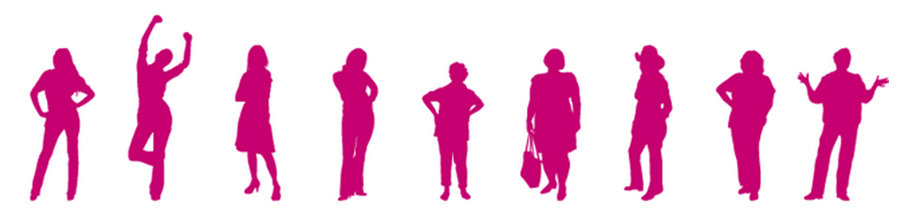
Introduction to the Alberta Breast Cancer Screening Program (ABCSP)
Please contact Bonnie Chiang, ABCSP Program Manager
at Bonnie.Chiang@ahs.ca if you have any questions

Slide 2

What is the ABCSP?
Led by AHS’ Screening Programs within the Population, Public and Indigenous Health portfolio
The ABCSP leads and coordinates provincial breast cancer screening program planning, implementation and evaluation
Represents Alberta at the Canadian Partnership Against Cancer’s (CPAC) Canadian Breast Cancer Screening Network Initiative
http://www.topalbertadoctors.org/download/244/breast_cancer_summary.pdf?_20170503164519
Notes:
Toward Optimized Practice (TOP) helps Alberta physicians and practice teams implement evidence-based practices to enhance the care of their patients.
In alignment with Alberta’s Primary Health Care Strategy, TOP strives to cultivate a culture of quality improvement to support physicians and teams with the work of building the best medical homes for Albertans.
We work with PCN, non-PCN and community-based specialist teams to implement specific, measurable, practical and evidence-based changes.
Through our programs, services and tools TOP is helping meet the challenge of keeping practices current in an environment of progressive change.
We are dedicated to quality improvement within our health system and believe together we can continue to do great things to our health system.

Slide 3
Our story…

Slide 4
The ABCSP
Provincial population based program
Target population: Average risk women aged 50-74
Practice Guideline
Alberta Toward
Optimizing Practice

Slide 5
Toward Optimized Practice
http://www.topalbertadoctors.org/download/244/breast_cancer_summary.pdf?_20170503164519

Slide 6
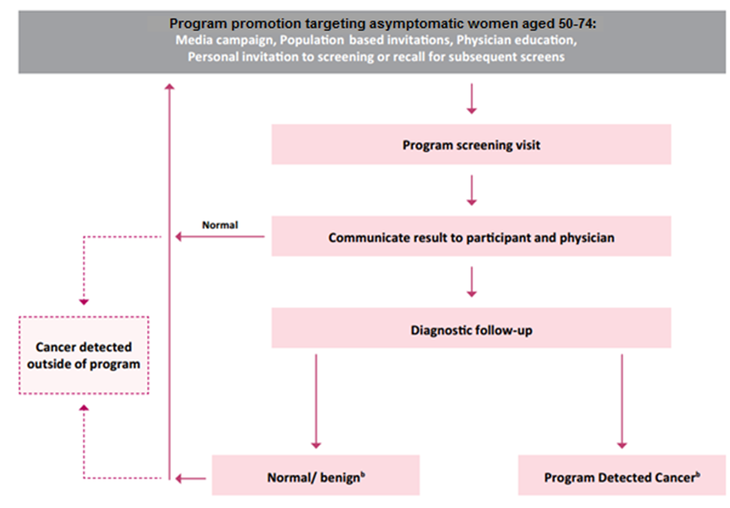
Breast Screen Pathway

Slide 7
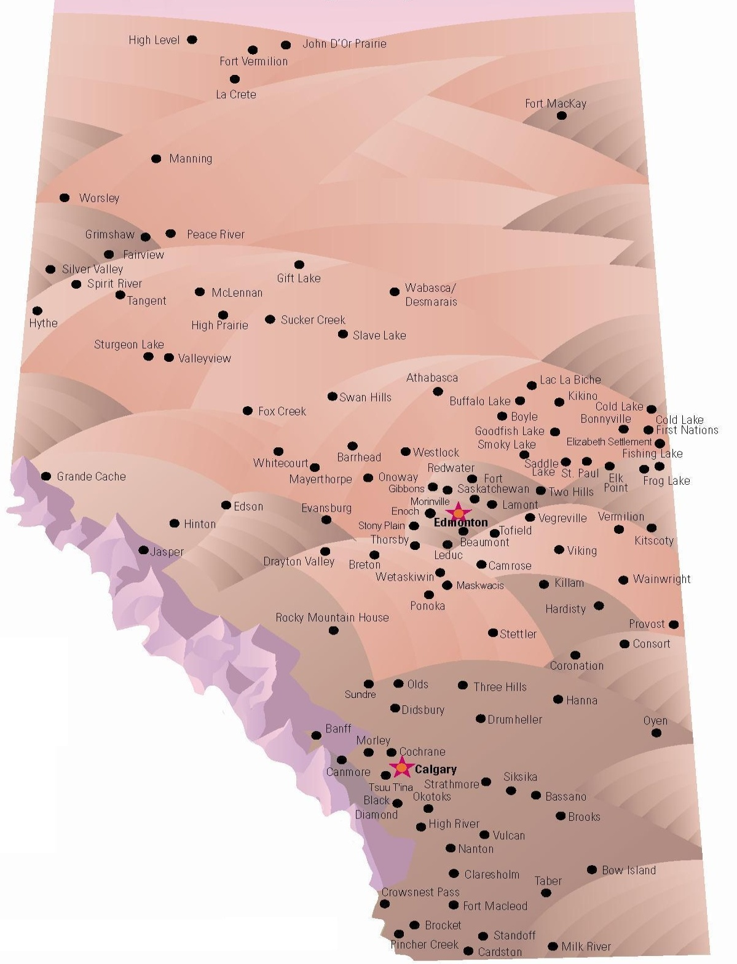

ASR
Screen Test
AHS DI
Notes:
~10 AHS sites
~63 community based clinics

Slide 8
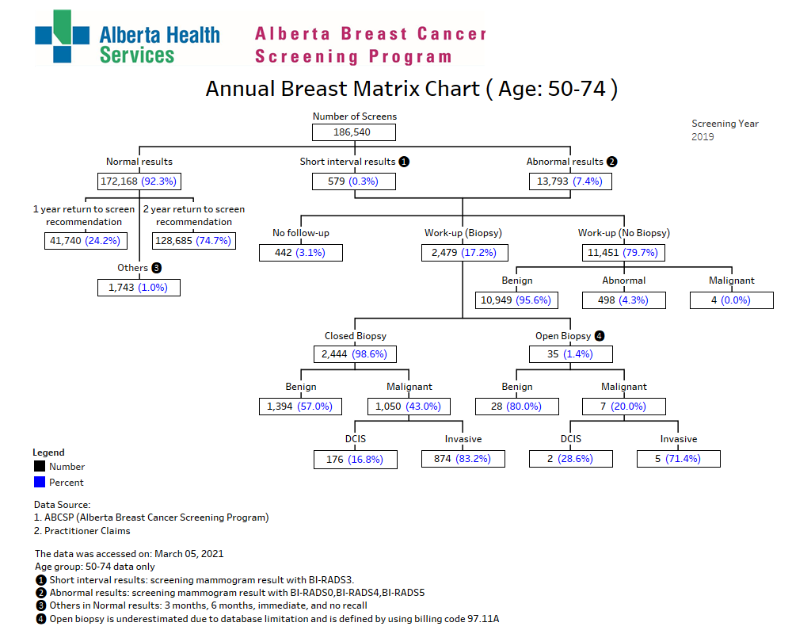

Slide 9
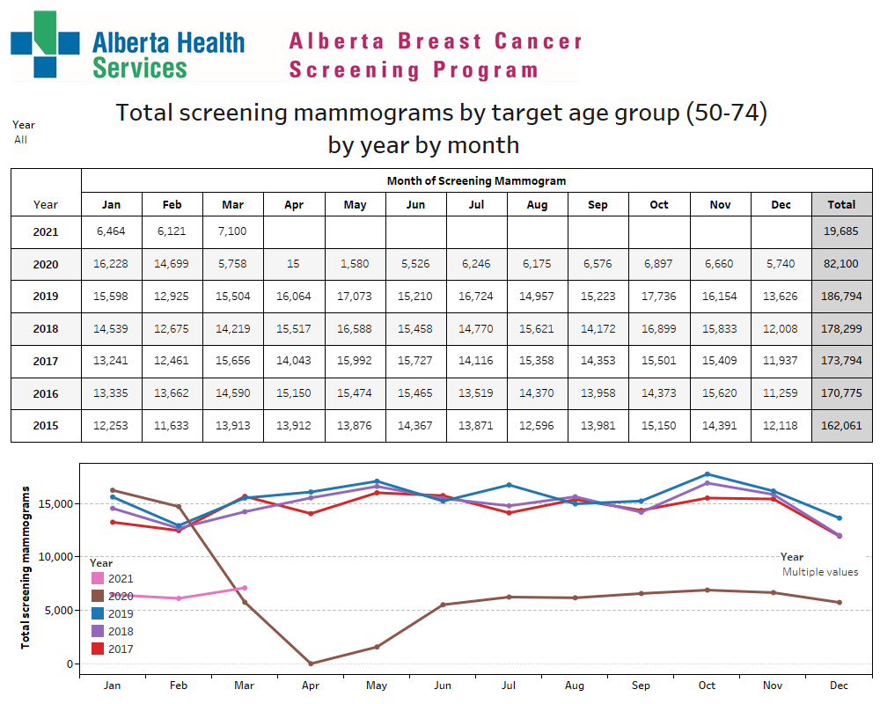
Breast Screening by Numbers

Slide 10

Vision Statement
The vision statement for the ABCSP is: Breast Cancer Screening For Life
Mission Statement
The ABCSP will promote health equity and increase breast cancer survival by providing a high quality, collaborative screening program that empowers women to make informed decisions about their breast health.

Slide 11
ABCSP’s Strategic Goals
70% of eligible population (50-74) will participate in breast cancer screening.
    2018-2019 rate is 64.9%
Through early detection, breast cancer screening will reduce breast cancer mortality by 30% for programmatic screeners.

Slide 12
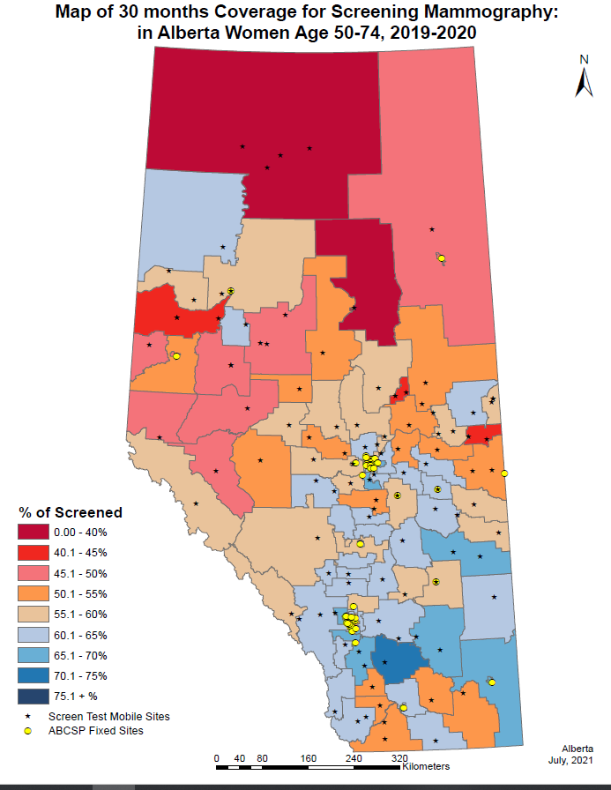
Screening Participation
Percentage of women 50-74 who have a screening mammogram within a 30-month period (2019-2020)
64.9%

Slide 13
Strategic Directions
1. Engage Women
Alberta
Women
4. Participate in Research
2. Build Partnerships
3. Enhance Program
Quality

Slide 14

1) Engage Women
Enable eligible women to make informed decisions about screening
  Reminder letters
  Breast density info on website
  Decision aid
  Facility lists
  Call number
Engagement ← how to do this better?
http://www.vacationrentalmarketingblog.com/wp-content/uploads/2012/06/openletter.png
Notes:
Breast density: http://screeningforlife.ca/breast-cancer-your-risk-factors/

Slide 15

1) Engage Women
Determine the role of personalized risk stratification in breast cancer screening in Alberta
  High risk differentiation
    Genetics
    Family history
    Chest wall radiation
    Benign breast disease
  Elevated/Intermediate risk
    Breast density
Survivorship
https://www.geneyouin.ca/wp-content/uploads/2013/09/breast_cancer_helix.png
Notes:
ABCSP is currently an average risk program.
Family history; genetics; breast cancer diagnosis (<10 years); mastectomy

Slide 16
1. Engage Women
Age Distribution, 2013 and 2014
Breast Cancer Screening in Canada: Monitoring & Evaluation of Quality Indicators – Canadian Partnership Against Cancer

Slide 17

2) Build Partnerships
Develop new and/or improve collaborations with partners to address equity and decrease disparities in breast cancer screening.
http://www.communityview.ca/images/2014_health_equity_SHR_health_equity.png

Slide 18
2. Build Partnerships
Ever Growing Collaborations
National Network
NB
QB
BC
CPAC/ PHAC
NS
ON
MB
SK
PEI
Territories
NFLD
ABCSP
AMA
CARNA
AH
CCS
PCNs
Zones
ACFP
CBCP
ISC
Cancer Control
PPIH
Genetics & Labs
Healthcare Providers
ASR
AHS, Screen Test
ABCSP
AHS DI
Engage Women
Notes:
PPIH: Provincial Population and Public Health
ISC – Indigenous Services Canada (Formerly FNIHB: First Nations and Inuit Health Branch)
CBCP – Comprehensive Breast Care Programs
CCS: Canadian Cancer Society
PCN: Primary Care Network
CARNA: College and Association of Registered Nurses of Alberta
CPAC: Canadian Partnership Against Cancer

Slide 19

3) Enhance Program Quality
Ensure robust data to support appropriate screening and minimize harms
  Breast Imaging Quality Assurance Committee (BIQAC)
    Section 9; QMPF
  Modality data
  CPAC
  Pathology
Provider engagement ←how to do this better?
http://digitalgrowth.ca/wp-content/uploads/2015/08/16.jpg
Notes:
BIQAC: Breast imaging and quality assurance committee
QMPF: Quality Management Partnership Framework

Slide 20
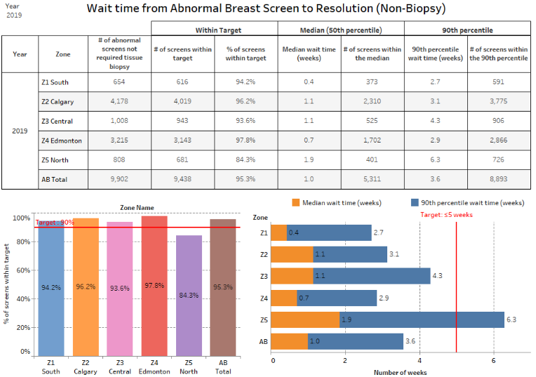
What we do really well…

Slide 21
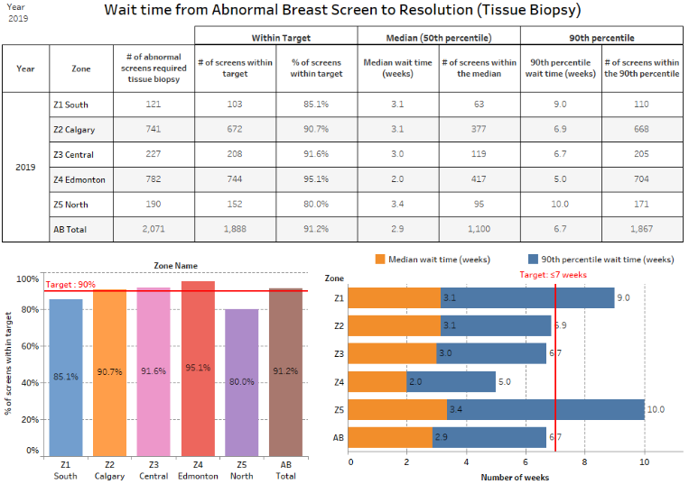
Improvement opportunity

Slide 22

4) Participate in Research
Advance the program’s research agenda
Support & participation in outside research activities i.e. CPAC, UoC, UoA
What does the research show about breast cancers that are detected through screening which would have been otherwise missed?
Improve outcomes/mortality?
Overdiagnosis?
http://static.oprah.com/images/o2/201410/201410-omag-breast-cancer-949x534.jpg
Notes:
UoC = University of Calgary
UoA = University of Alberta
CPAC = Canadian Partnership Against Cancer

Slide 23
Alberta Breast Cancer Screening Program’s Advisory Committee
Purpose:
The Alberta Breast Cancer Screening Program’s Advisory Committee (ABCSP AC) provides oversight and advice to support effective, population-based breast cancer screening programs in Alberta.
Functions:
The ABCSP AC supports the ABCSP in achieving their program vision, goals and objectives by:
Reviewing policy, standards and guidelines that govern breast cancer screening program activities
Advising on provincial standards for professional education related to breast cancer screening
Applying continuous improvement strategies towards overall program performance through monitoring of data variables/elements
Facilitating the exchange of and promoting consistency in the delivery of program information
Ensuring appropriate communication linkages are maintained among key stakeholders in Alberta and with national initiatives on breast and cervical cancer screening

Slide 24

Standards & Guidelines

Slide 25
Standards & Guidelines
Living document: always under review and revision
High level: provides overarching program guidance
Evidence based: uses best available evidence for recommendations
Partnership: collaborative approach
Click document to read
http://www.cancernetwork.com/sites/default/files/2146294.png

Slide 26
Organized Cancer Screening in Alberta 2015 Report
The document highlights Alberta Health Services’ Cancer Screening Programs to give an overview of how the system works and some of the relevant breast cancer statistics. For more information, contact the Alberta Breast Cancer Screening Program directly or check out the website at screeningforlife.ca.
Click document to read

Slide 27
Onboarding New Clinics
Each new clinic is required to register with the ABCSP The document allows for the clinic to be included on the facility lists given to potential screeners and ensures your site has access to all of the other benefits the ABCSP offers such pre-printed result letters with branded letterheads, yearly feedback reports, and much more.
Click document to read

Slide 28
Individual Screening Mammographer Feedback Report
The following is an example of an Individual Screening Mammographer Feedback Report. The Alberta Breast Cancer Screening Program (ABCSP) along with the Breast Imaging Quality Assurance Committee (BIQAC) send these reports out every year to individual mammographers in the province of Alberta. This individual and confidential report is intended to guide your practice by indicating your performance in regard to the ABCSP’s quality assurance targets and relative to your provincial peers. We recommend that you review the information when you receive your own report to help you better understand your strengths and where you would most benefit to focus your improvement efforts.
Click document to read

Slide 29
ABCSP Letter Templates
The following are templates of the information sent out to women in the Alberta Breast Cancer Screening Program (ABCSP).
Click documents to view

Slide 30
Patient Letters
Welcome to the Alberta Breast Cancer Screening Program (ABCSP) & FAQs
This invitation letter is sent directly from the ABCSP to women as they age into the program (50 years of age). It is meant to introduce eligible women to the program and answer some of the questions they may have.
Result Letters – sent by radiology clinic
The ABCSP generates templates of these letters but they are sent out by the radiology clinic following the exam. The ABCSP also provides clinics with the letterheads and envelops for these letters.
Reminder Letter
This letter is sent directly from the ABCSP to women when they are due for their next mammogram and our records show they have not recently had one. It is meant as a reminder for the woman to take action and book her next mammogram.

Slide 31

CPAC Report
Breast Cancer Screening in Canada – Monitoring & Evaluation of Quality Indicators (Report)
The following report comes from the Canadian Partnership Against Cancer (CPAC). CPAC collects cancer data nationwide and produces reports and recommendations based on the findings. In the following report you will find useful information on the benefits and harms of screening supported by various data elements collected from each province/territory.
Click document to read

Slide 32
Thank You
Please take the time to complete this 3 minute survey to provide your feedback on this resource.
https://survey.albertahealthservices.ca/ABCSPresourcebinder

